Slide 1

NETWORKING virtual
private network

Slide 2
Customer gateways

Slide 3
Virtual private gateways

Slide 4
Site to site VPN connections

Slide 5
VPN ENDPOINTS

Slide 6
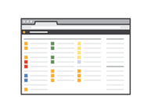


HOW IT IS USED
AWS Management Console
AWS Command Line Interface
AWS Software Development Kit

